Slide 1
The National FAA Safety Team Presents
Topic of the Month July
Short Field Operations
KFNL Pilots
Jer Eberhard
May 2026
Notes:
2022/03-17-252(I)PP Original Author: J. Steuernagle August 2023 POC: K. Clover, National FAASTeam Program Mgr. (Operations) Office 562-888-2020
Presentation Note: This is the title slide for Short Field Operations
Script - We have included a script of suggested dialog with most slides. The script will always appear in a non-italic font. Presenters may read the script or modify it to suit their own presentation style.
Presentation Instructions - (stage direction and presentation suggestions) will be preceded by a Bold header: the instructions themselves will be in Italic fonts. See slides 2, for an example of slides with Presentation Instructions only.
Program control instructions - will be in bold fonts and look like this: (Click) for building information within a slide; or this: (Next Slide) for slide advance.
Background information - Some slides may contain background information that supports the concepts presented in the program. Background information will always appear last and will be preceded by a bold Background: identification.
The production team hope you and your audience will enjoy the show. Break a leg!
(Next Slide)

Slide 2
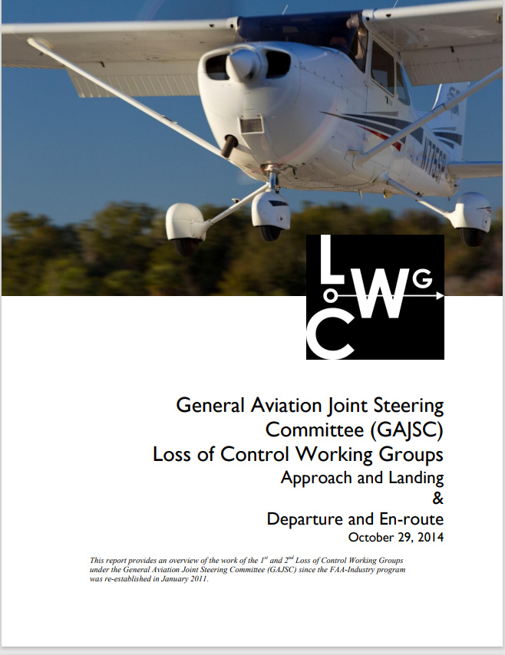
Overview
Short Field Operations
Planning
Execution
Tips & Tricks
* General Aviation Joint Safety Committee
Notes:
In this program we’ll discuss short field operations, their planning, and execution. We’ll also pass on some useful tips and tricks for short field operations success. Because inaccurate or incomplete performance calculations and improper short field technique are cited as causal factors, the GAJSC feel that additional training in short field operations may reduce loss of control and controlled flight into terrain accidents.
Presentation Note: If you’ll be discussing additional items, add them to this list
(Next Slide)

Slide 3
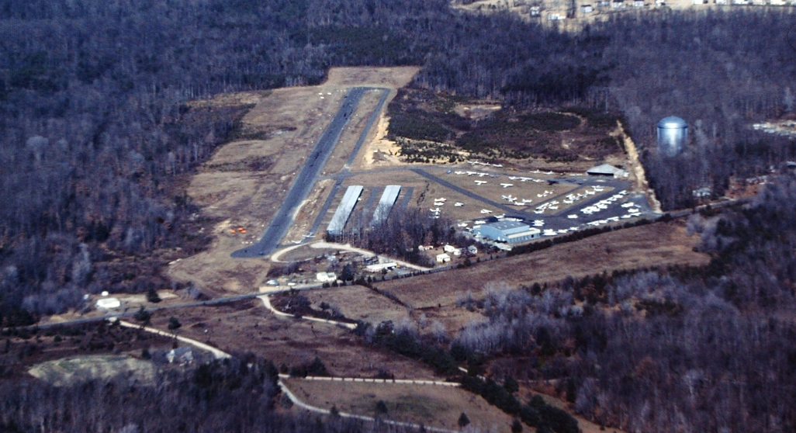
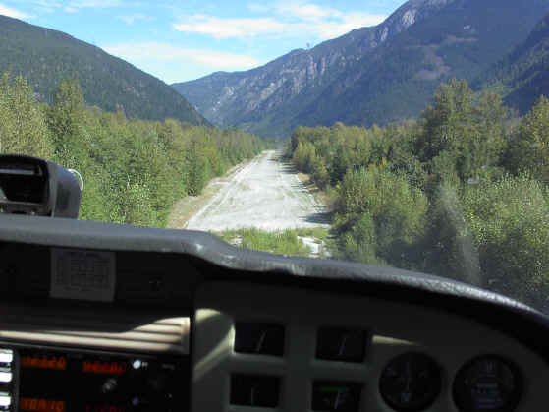
What’s a short field?
Notes:
What constitutes a short field for one pilot may be more than adequate for another. The 2,300-foot runway on the right might be daunting to pilots used to runways more than twice as long. (Click)
But that same runway would appear huge to pilots used to operating to this back-country strip. So, what’s considered short is very much a question of your aircraft’s capability, your competence and experience. Regardless you’ll want to plan your operation in advance and practice to proficiency. You’ll want to calculate takeoff and landing distances based on information contained in your Pilot’s Operating Handbook of course, but then you’ll want to confirm those figures with an actual flight or two.
(Next Slide)

Slide 4
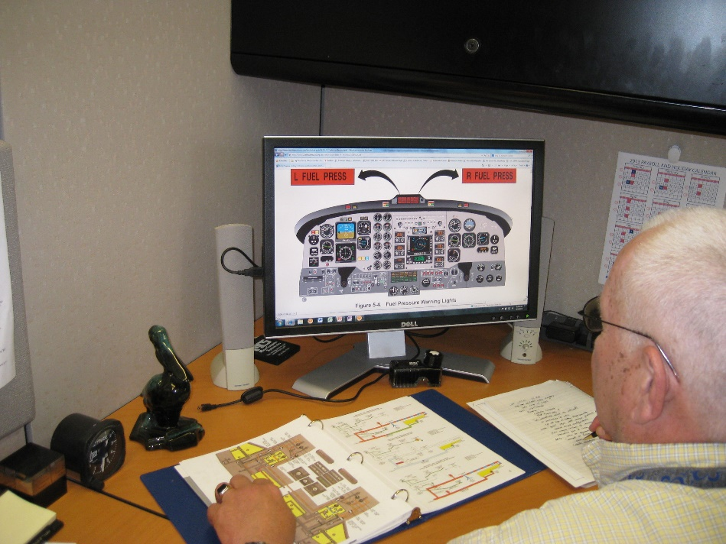
Read the book
Pilot’s Operating Handbook
Performance Charts
Speeds for safe operation
Normal & Emergency procedures
Short field T.O. & Landing procedures
Notes:
We begin with the POH and a refresher on aircraft performance, speeds for safe operation, normal and emergency procedures and guidance on short field takeoffs and landings.
The POH is the first place to look for specific aircraft short field operating instructions.
(Next Slide)

Slide 5
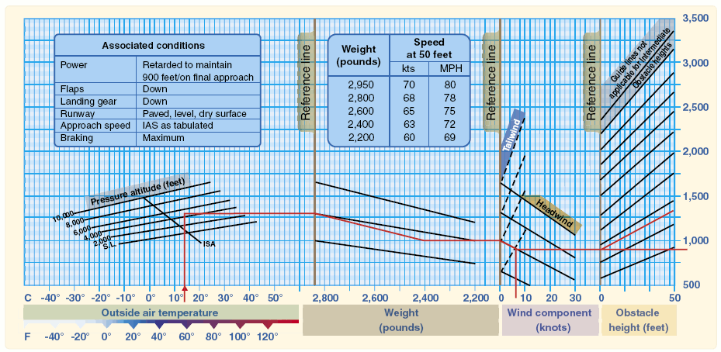
Do the math
Notes:
Happily, most POHs have done the math for us and provide performance data in graphical form.
(Next Slide)

Slide 6
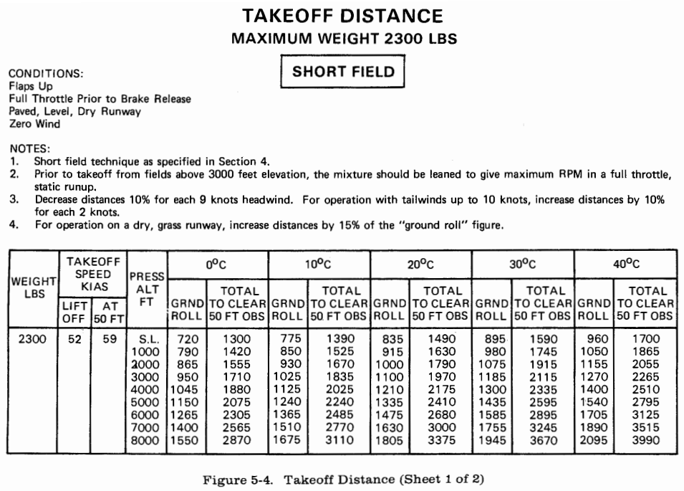
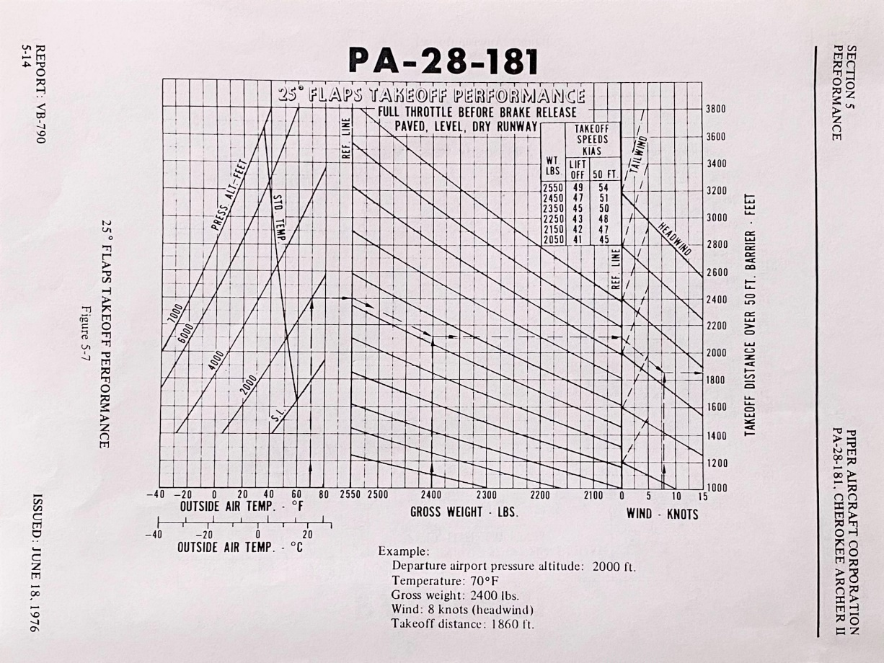
Takeoff Performance
Notes:
Normal and Short Field Takeoff performance are addressed. (Click)
It’s vitally important to note the conditions on each document. The chart on the left is predicted on a gross weight of 2300-pounds. Lighter weights will naturally result in higher performance. The right-hand chart includes Takeoff weight as a variable so pilots can predict better performance with lower density altitudes and lighter loads.
(Next Slide)

Slide 7
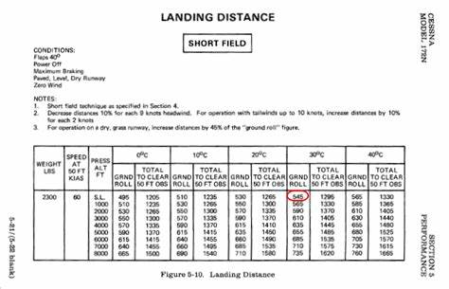
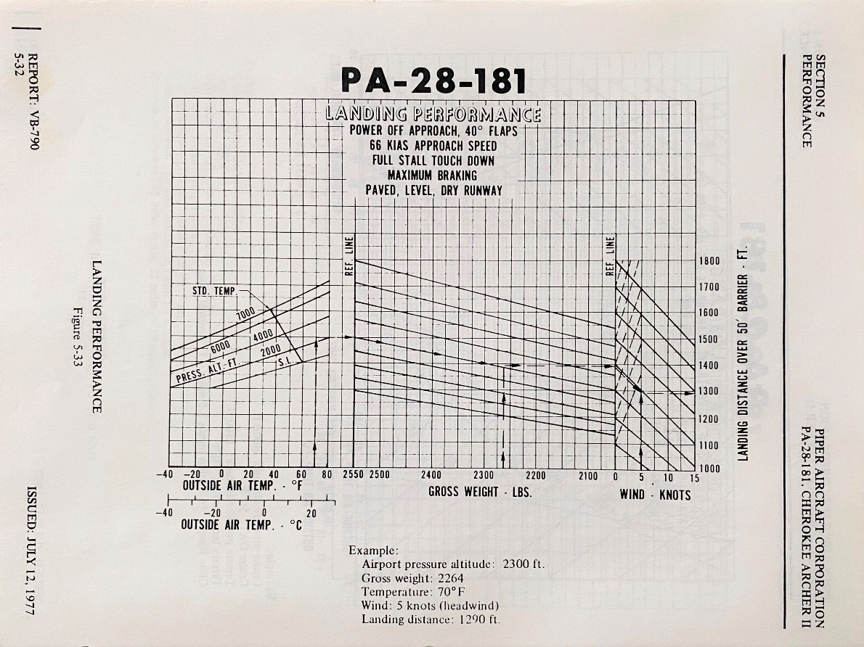
Landing Performance
Notes:
Here are typical Short Field landing performance graphs. Note that each contains environmental conditions and aircraft configurations.
(Next Slide)

Slide 8
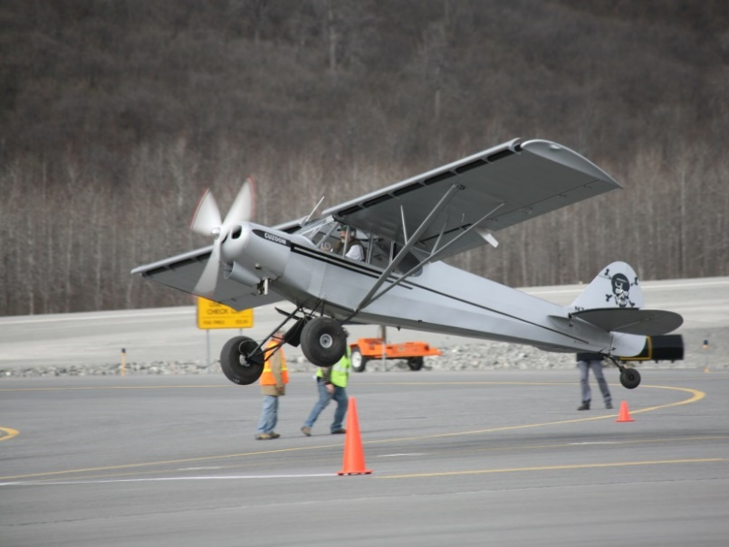
Takeoff Calculations
Vx, Vy, and Cruise climb
Density altitude
Fixed pitch add 15% per 1000 feet DA to 8000 ft.
Constant speed add 12% per 1000 feet DA to 6000 ft.
50/70 Rule – no obstruction
60 x .7 = 42
30/70 Rule - obstruction
Notes:
Your POH will cite speeds for best angle of climb (Vx), and best rate of climb (Vy) For all short field takeoffs, plan to accelerate to and maintain Vx until obstacles are cleared, then transition to Vy or cruise climb as appropriate.
Here are some rules of thumb when making takeoff calculations. (Click)
If you have a fixed pitch prop, add 15% to your calculated takeoff distance for each 1,000-foot increase in density altitude up to 8,000 feet. (Click)
For constant speed props add 12% per 1,000 feet of density altitude up to 6,000 feet. (Click)
When planning takeoff from short unobstructed runways establish a landmark at 50% of your calculated takeoff distance. (Click)
When on the takeoff roll you should have 70% of your rotation speed at that point. If you don’t – the safest thing is to abort the takeoff and reduce weight or wait for more favorable wind and temperature conditions. In this example we’re assuming a rotation speed of 60 knots or MPH. 70% of 60 is 42. The number you’ll want to see at the halfway point (Click)
If you must clear obstructions on takeoff you’ll need to have 70% of your rotation speed by the time you’ve travelled 30% of your available takeoff distance.
By the way – the photos on this and subsequent slides are of an annual takeoff and landing competition held in Valdez, Alaska. We strongly suggest you don’t try this at home without some quality short field instruction.
(Next Slide)
(Next Slide)

Slide 9
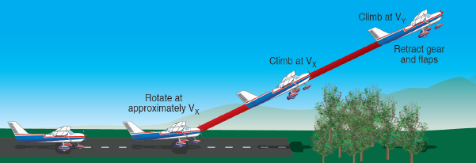
Short Field Takeoff: Use ALL the Runway!
Rotate at and maintain Vx
Until obstacles are cleared or 50 feet above runway
Transition to Vy
When safe to maneuver
Notes:
From the end of the runway apply full power and rotate at Vx. Some pilots prefer to hold brakes until power is applied but studies have shown that there is little or no benefit to the practice. As VX approaches, apply back-elevator pressure until reaching the appropriate VX attitude to ensure a smooth and firm lift-off, or rotation. Since the airplane accelerates more rapidly after lift-off, pilots should apply additional back-elevator pressure to hold a constant airspeed. After becoming airborne, maintain a wings-level climb at VX until all obstacles have been cleared, or if no obstacles are present, until reaching an altitude of at least 50 feet above the takeoff surface. Thereafter, pilots may lower the pitch attitude slightly and continue the climb at VY until reaching a safe maneuvering altitude.
(Next Slide)

Slide 10
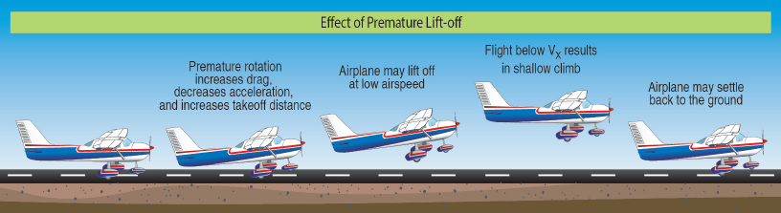
Don’t rush the takeoff
Notes:
Attempts to pull the airplane off the ground prematurely, or to climb too steeply, may cause the airplane to settle back to the runway or contact obstacles. Even if the airplane remains airborne, until you accelerate to VX, the initial climb will remain flat, which diminishes your ability to successfully perform the climb and/or clear obstacles.
(Next Slide)

Slide 11
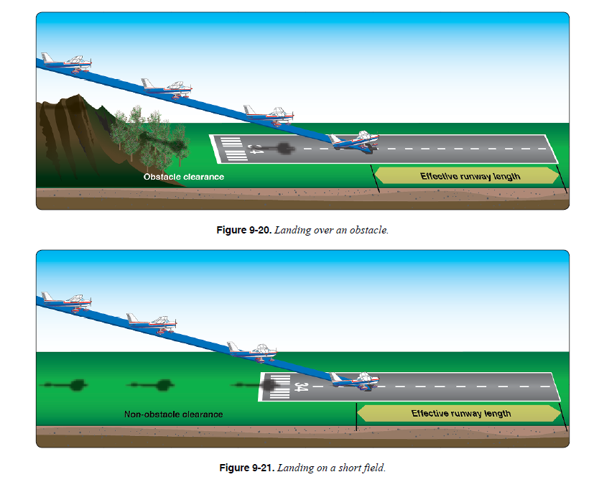
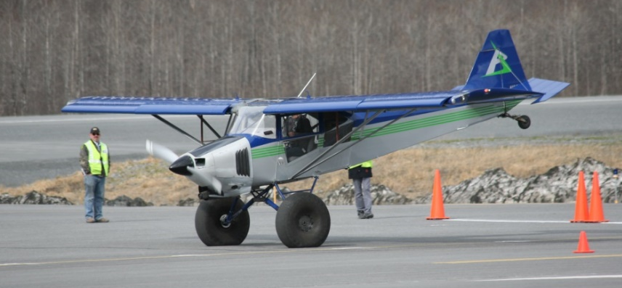
Short Field Approach & Landing
Stabilized short field final approach
Landing configuration
Full flaps
1.3vso
Don’t cut final short
Go around if not stable
Notes:
As with all landings, you’ll want to be stabilized on final approach in landing configuration with full flaps at the manufacturers recommended short field approach speed. If no short field speed is recommended, we suggest 1.3 times the stalling speed in landing configuration.
Don’t cut your final short. Make it long enough to be stabile and go around if you’re unstable.
(Next Slide)

Slide 12
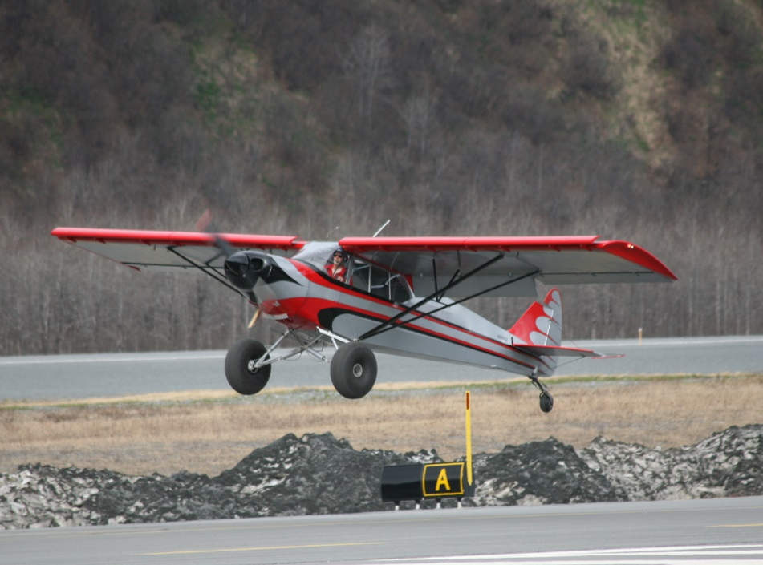
How do I know? Complications!
Predict performance
Prove your prediction
Practice to maintain proficiency
Weather
Density Altitude
Runway Slope
Obstructions
Aircraft weight
Notes:
You know what the book says but how do you know you’ll achieve book performance? For that, you’ll have to actually fly under the same conditions you expect to find at that short field you’ve been wanting to explore. We suggest that you and your CFI explore your capabilities in your aircraft. That will give you a baseline performance expectation that you can use for short field calculations. (Click)
But that baseline will only be accurate if you practice to maintain that level of proficiency.
For instructions on establishing baseline performance, we suggest you review the Alaskan Off-airport Operations Guide available on FAASafety.gov
(Next Slide)

Slide 13
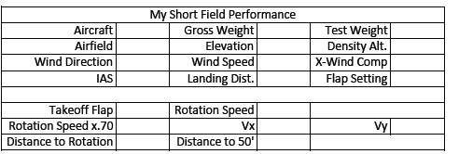

What’s my baseline?
https://tinyurl.com/yjn5kdsp
Notes:
Here’s a sample baseline calculation sheet extracted from the Alaskan Off-Airport Operations Guide available at the URL below.
To establish your baseline, we suggest you load your aircraft with a typical mix of fuel, cargo, and passengers. (We recommend that one of those passengers be your CFI.) Calculate your test weight and note runway condition, elevation, density altitude, wind direction and speed. (Click)
Also note what rotation and climb speeds you intend to use and calculate 70% of the rotation speed. That will give you a base figure for your 50/70 or 30/70 rule target airspeed.
Next, you’ll fly several takeoffs and landings noting your performance on each trial. When you’re done you can average your performance figures and complete your baseline chart.
(Next Slide)

Slide 14
So, when do I go around?
Whenever the approach becomes unstable
At or below 1000 ft – IFR
At or below 500 ft – VFR
Whenever a landing can’t be made
Make the decision early
Stick to it
Changing your mind is destabilizing
Notes:
A best practice requires that we go around if an approach becomes unstable at or below 1,000 feet IFR or at or below 500 feet in VMC conditions. Most approaches to really short fields will be VFR, but what about one way in and one way out destinations? In those cases, there will be a point beyond which our only option is to land, so it’s imperative that we make the go-around decision while we still have maneuvering room. Waiting until 500 feet to make the go-around decision may be too late.
In all cases it’s best to make the go-around decision as early as possible and, once made, stick to it. Changing your mind during a go-around is destabilizing.
And, when we are compelled to change our plans there are three priorities to consider.
(Next Slide)

Slide 15
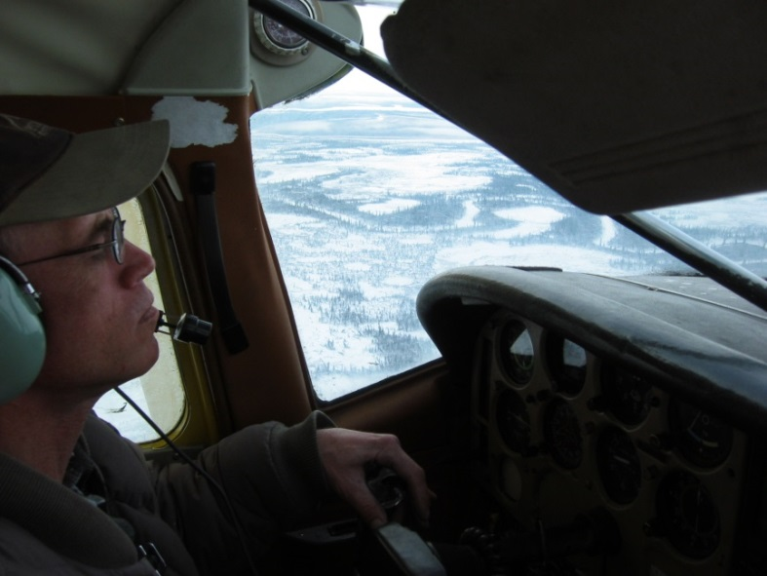
Go-around & Missed Approach Priorities
Aviate
Maintain aircraft control
Arrest descent
Apply climb or level flight power
Configure for climb or level flight
Notes:
When missing an approach or going around you’re usually pretty close to the ground so your first priority is to maintain aircraft control. Arrest your descent, apply power to maintain altitude or climb as appropriate, and configure the airplane for climb or level flight.
(Next Slide)

Slide 16
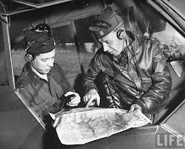
Go-around & Missed Approach Priorities
Navigate
IFR Continue to missed approach point then
Fly the missed approach procedure or
Follow ATC instructions
VFR Continue to runway threshold & climb to pattern altitude then
Maneuver to remain in or reenter pattern or
Follow ATC instructions
Notes:
With the aircraft under control and not descending it’s time to navigate. If you’re IFR, continue to the missed approach point and then either fly the published missed approach procedure or follow ATC instructions.
VFR - continue to the runway threshold, unless this is a one-way in and out field, while climbing to pattern altitude then either maneuver to remain in or reenter the pattern or follow ATC instructions as appropriate.
(Next Slide)

Slide 17
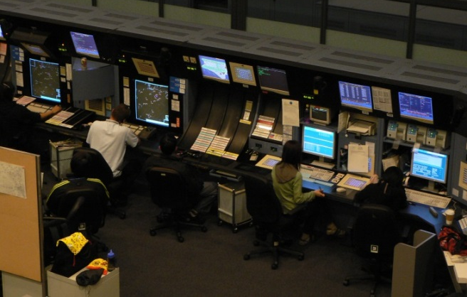
Go-around & Missed Approach Priorities
Communicate
IFR
Tower or local traffic advisory frequency
ATC – state intentions
VFR
Tower or local traffic advisory frequency
Notes:
When we’re safely aviating and navigating it’s time to let other folks in on our plans. Communicate your intentions to ATC if IFR or in a towered environment. IFR operations to non-towered airports require a call to ATC and perhaps a call on the common traffic advisory frequency.
VFR will be one call only on the tower frequency or local traffic advisory frequency as appropriate.
(Next Slide)

Slide 18
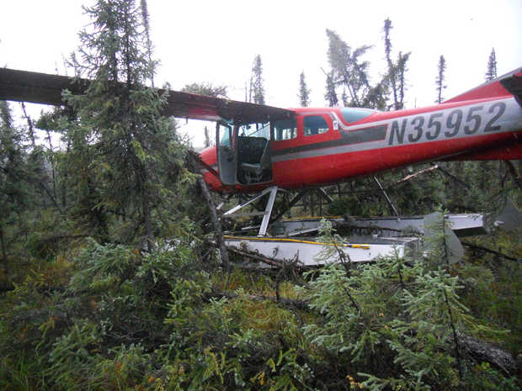
Priority!!!! Fly the Aircraft First!
High stress
Short time frame
Limited options
Off airport landing?
Notes:
I know we all talk the Fly the Aircraft First talk but can we walk the talk? By that we mean of course; are we really prepared to fly the airplane under high stress to a safe – perhaps off airport – landing?
(Click)
The pilot of this aircraft had a total engine failure – mechanical – not fuel related – while en route at low altitude in Alaska.
Navigation was simple – we’ll be on the ground in a minute or two - well before we can get to anything that even remotely resembles an airport.
Communication was also simple – there was no one within radio range to talk to.
We’re not likely to be as successful as this pilot unless we think about what we’re going to do in various possible emergency situations and unless we prepare do deal with problems.
(Next Slide)
Background: The NTSB investigation report of this accident is: (ANC13LA085)

Slide 19

So how do we prepare for problems?
Consider the hazards associated with each phase of flight
Think about what could go wrong
Plan for how you would deal with the problem
What would I do if?
What could I have done better
Train to plan proficiency
Practice – preferably with a CFI
Notes:
So how do we prepare for problems? We think about what could go wrong. It’s useful to consider things that could go wrong in each phase of flight. Generally speaking – problems are more serious – the less room we have to maneuver. Looking at it that way – a power loss on climb out would be more serious than one at altitude or in the pattern when a landing is assured.
We plan for how we would deal with the problem. Successful pilots consider, “what would I do if?” before and during flight. And and after each flight they consider, “what could I have done better?”
And finally, we train to proficiency and practice – preferably with a CFI who can coach us to achieve our maximum performance.
(Next Slide)

Slide 20
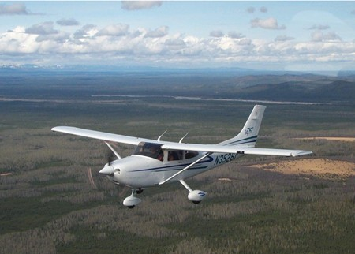
Preparing for Problems
Prepare
Performance numbers, weather, survival gear
Plan
Route, flight plan, runway data, climb & descent profiles, escape routes, go no-go points & alternates
Practice – at mission weight
Short & soft field T.O. s & Ldgs.
Power off Appchs. & Ldgs.
Notes:
To maximize our chances of success in handling emergencies, we prepare, plan, and practice. (Click)
We prepare by making sure we know our performance numbers including best power off glide speed for the aircraft we’re going to fly. We have a good weather brief, and we update along the route, so we always know where the best weather is. We file a flight plan and request flight following service We have survival gear appropriate to the mission on board and we know how to use it. (Click)
We plan our route with alternate landing areas in mind. This means we may elect to take a longer route that offers better alternatives for off airport landings. We file a flight plan and request flight following. We plan and brief each takeoff, approach, and landing to include climb & descent expectations, go no-go points, escape routes, and alternates. En route we keep within gliding distance of suitable landing areas for as much of the flight as possible (Click)
And we practice emergency procedures, short and soft field takeoffs and landings; power off approaches and landings. It’s important to practice these maneuvers at our expected mission weight. An aircraft with a solo pilot and half tanks performs much better than one at close to max gross weight. Pilots need to be comfortable at the higher weights in order to be successful in real emergencies.
(Next Slide)

Slide 21
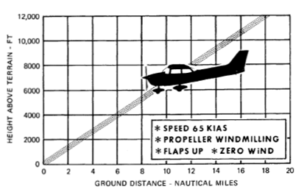
Power Loss
Fly the airplane
Establish, configure for, & maintain best glide speed
Identify landing site
Maneuver toward landing site
Diagnose the problem
Loss of power checklist (s)
Restore power and continue or….
Land
If possible, activate ELT & cell phone (s) before landing
Notes:
Let’s consider a sudden and unexpected loss of power. What’s the first and most important thing we must do?
Presentation note: Wait for the audience to answer. Usually they will say, “Fly the airplane!” then: (Click)
That’s right – If we don’t maintain aircraft control this will not end well. While maintaining control; establish, configure for, and maintain best glide speed. (Click)
If we’re VFR or maneuvering near an airport we should already have some idea of suitable off airport landing sites nearby. Heading toward the best choice of these is good insurance in case we’re unable to restore power. (Click)
Now, if there’s sufficient time, we can try to diagnose and correct the problem. The POH will likely have some checklists to follow but, because most power loss events are fuel related, Mixture – Rich, Fuel Pump – On, Fuel – On Proper Tank will often do the trick. But if we can’t restore power ……. (Click)
We land - keeping the aircraft under positive control throughout. If you can keep everything under control and you have a remote ELT switch, activate the ELT while maneuvering to land and turn cell phones on. Both will help in guiding rescuers to your landing site.
If we are able to restore power - unless we’re sure we know what caused the power loss, we know we’ve corrected the problem, and we’re emotionally and intellectually prepared to continue the flight, a precautionary landing is in order. At least it can be at an airport of our choosing instead of a farmer’s field. Seriously – responding to emergencies is physically, emotionally, and intellectually draining. Time spent regrouping on the ground is well spent.
(Next Slide)

Slide 22
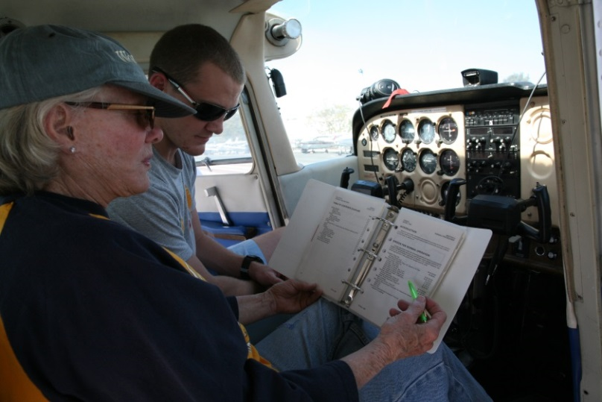
Tips & Tricks
Fatal Distractions
Set passenger expectations
Sterile Cockpit
Give passengers a job
Practice Short Field Operations
Even at longer airports.
Proficiency Training
Document in WINGS
Notes:
Passengers – and in some cases animals - have been known to provide fatal distractions so pilots must set expectations before flight. In addition to the standard seat belts, exits, and emergency equipment brief, take some time to explain your role and theirs. Insist on a sterile cockpit – no conversation that is not directly related to safety of flight during critical times. Give your passengers a job to do such as scanning for traffic. We know of one pilot who pays his kids a dollar for each aircraft they spot before he does. After one flight alone he had to visit an ATM to pay off his debt. (Click)
Practice short field operations regularly – even at airports where you have plenty of room. Challenge yourself to touch down at specific points on the runway. This will improve accuracy as well as short field technique. (Click)
And finally, seek regular proficiency training with your CFI and document your training in WINGS.
(Next Slide)

Slide 23


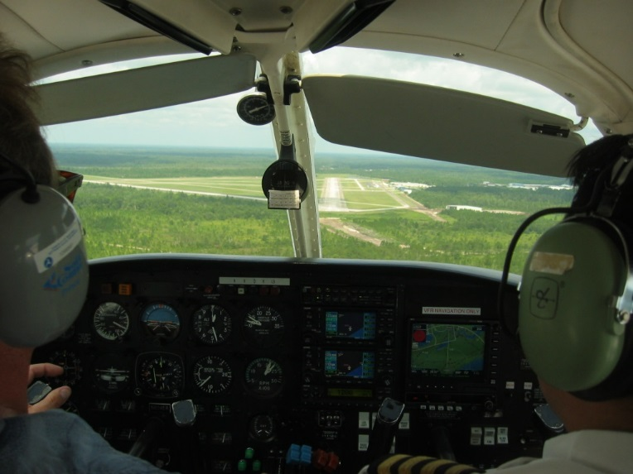
Recommendations:
Gold Seal
Brief each takeoff, approach, and landing
Runway and available distance for takeoff or landing
Aircraft configuration and target airspeeds
Rejected takeoff or landing decision point
Departure/approach path
Return to airport altitude
Forced landing opportunities
Notes:
Briefing every takeoff, approach, and landing is another gold seal best practice. When emergencies occur during these critical phases of flight, there will be little or no time to think about what should be done before doing it. Vocalizing important points and procedures just before takeoff or landing keeps them uppermost in your mind where they’re available for ready reference if something unforeseen happens. (Click)
Brief the assigned runway and available distance for takeoff or landing. Include aircraft configuration and target airspeeds. Vocalize your rejected takeoff or go-around decision point.
Include the departure or approach path and the altitude below which you’ll not attempt a return to the airport.
Finally, brief forced landing opportunities close to the airport.
(Next Slide)

Slide 24
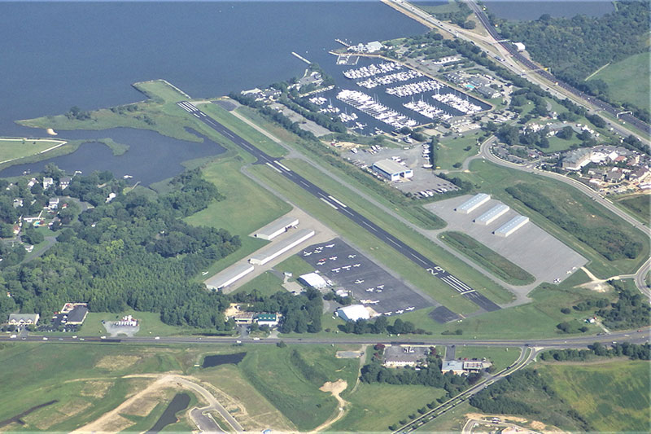
Pattern Precision
Unusable portions of runway
Forced landings
Precise flying breeds confidence and it looks good!
Gold Seal
Notes:
We’re all familiar with pattern operations. They’re an essential part of every flight. But sometimes we take routine tasks for granted and that can lead to less precise flying. You may ask, “What does it matter if I land a little long? I have 4 times the runway I need.” Well even if you never fly to shorter fields, it’s still important to be precise on longer runways for three reasons: (Click)
Runways occasionally are compromised so you may have less distance available to land. (Click)
Our aircraft are extremely reliable, but we may have to carry out a forced landing at any time. (Click)
And last but certainly not least - precise flying in the pattern makes you sharper in other flight procedures – including short field operations - It breeds confidence in you and in your passengers and besides; it looks good!
(Next Slide)

Slide 25

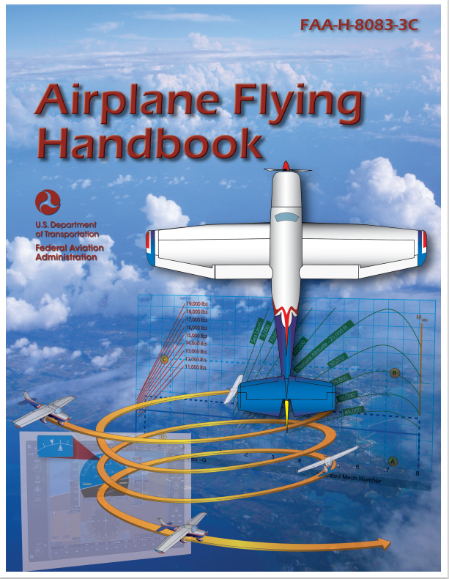

Want to learn more?
Airplane Flying Handbook
https://bit.ly/3wO1wMu
FAASTeam WINGS Pilot Proficiency Program
http://faasafety.gov/WINGS
Notes:
Want to learn more?
Check out the Airplane Flying Handbook – available at the web address shown.
Want to learn even more? Participate in the FAASTeam WINGS Proficiency Program. It’s a great way to get expert coaching that will keep you at the top of your flying game.
Presentation note: You can take questions while audience is copying information from this slide. Then advance to:
(Next Slide)

Slide 26

Questions/Comments?
Do you brief your departure?
Do you brief your approach?
Do you brief your Go Around Point?
Notes:
Presentation Note: You may wish to provide your contact information and main FSDO phone number here. Modify with
Your information or leave blank.
(Next Slide)

Slide 27
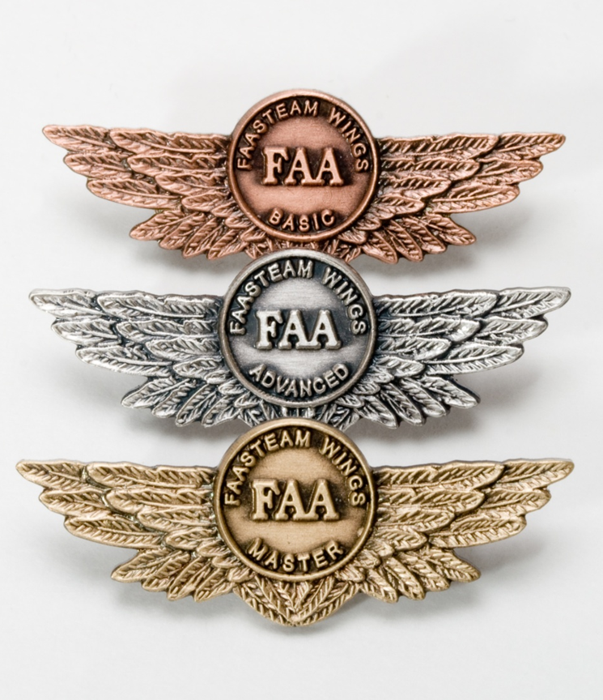
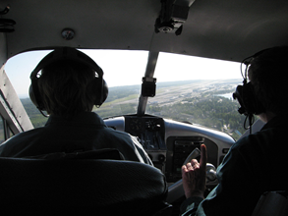
Proficiency and Peace of Mind
Fly regularly with your CFI
Perfect Practice
Document in WINGS
Notes:
There’s nothing like the feeling you get when you know you’re playing your A game and in order to do that you need a good coach (Click)
So fly regularly with a CFI who will challenge you to review what you know, explore new horizons, and to always do your best. Of course you’ll have to dedicate time and money to your proficiency program but it’s well worth it for the peace of mind that comes with confidence. (Click)
Vince Lombardi, the famous football coach said, “Practice does not make perfect. Only perfect practice makes perfect.” For pilots that means flying with precision. On course, on altitude, on speed all the time. (Click)
And be sure to document your achievement in the WINGS Proficiency Program. It’s a great way to stay on top of your game and keep you flight review current.
(Next Slide)

Slide 28
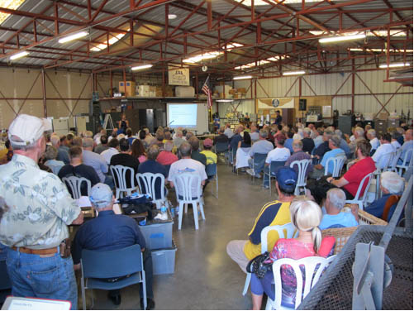
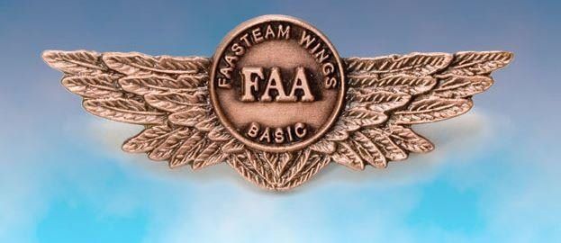
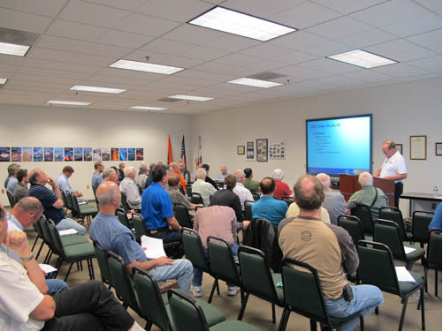
Thank you for attending
You are vital members of our GA safety community.
Notes:
Your presence here shows that you are vital members of our General Aviation Safety Community. The high standards you keep and the examples you set are a great credit to you and to GA.
Thank you for attending.
(Next Slide)

