Slide 1
Short Field Operations
Cessna 172 (160 HP)
Runway: 3750 ft
Density Altitude: 6000 ft
Tailwind Scenario Included

Slide 2
Objective
Understand performance limits and safe operation for short-field takeoff and landing.
Consider this Aircraft
C172 160 HP
Normally aspirated
Performance sensitive to DA and weight

Slide 3
Airport Environment
Runway Length: 3750 ft
High elevation → 6000 ft DA
Reduced air density
Density Altitude Effects
Reduced engine power
Reduced propeller efficiency
Reduced lift

Slide 4
Weight Considerations
Higher weight increases takeoff roll
Reduces climb rate
Increases landing distance
Wind Components
Headwind reduces distance
Tailwind increases distance significantly

Slide 5
Takeoff Technique
Full power before brake release
Short-field rotation speed
Climb at Vx

Slide 6
Takeoff Risk Factors
High DA
Tailwind
Obstacles
Overweight aircraft

Slide 7
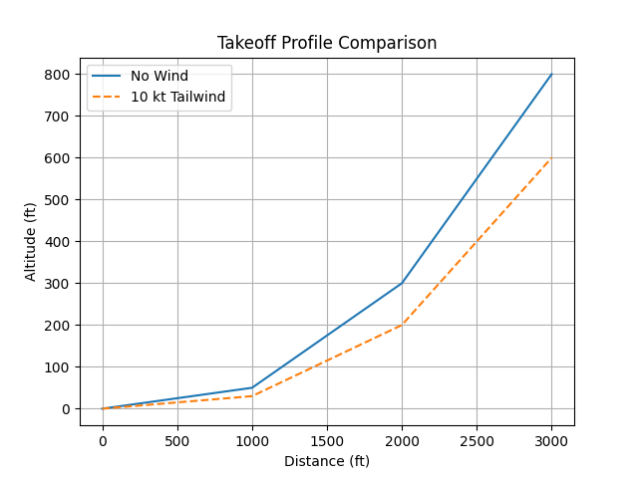
Takeoff Profile Comparison

Slide 8
Landing Technique
Stabilized approach
Full flaps
Aim point control
Maximum braking
Landing Risk Factors
Tailwind increases groundspeed
Longer float distance
Reduced stopping margin

Slide 9
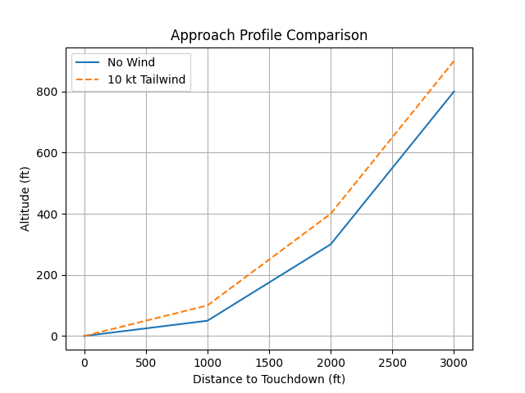
Approach Profile Comparison

Slide 10
Mitigation Strategies
Tailwind Impact
10 kt tailwind can increase distances by 20–40% or more
Reduce weight
Fly early morning
Use headwind runway
Abort if needed

Slide 11
Go/No-Go Decision
Compare required vs available runway
Maintain safety margin
Consider alternates

Slide 12
Common Pilot Errors
Improper speed control
Late rotation
Floating on landing

Slide 13
Discussion
Summary
Short-field ops require planning
Tailwinds greatly increase risk
Use conservative decision-making

